Slide 1
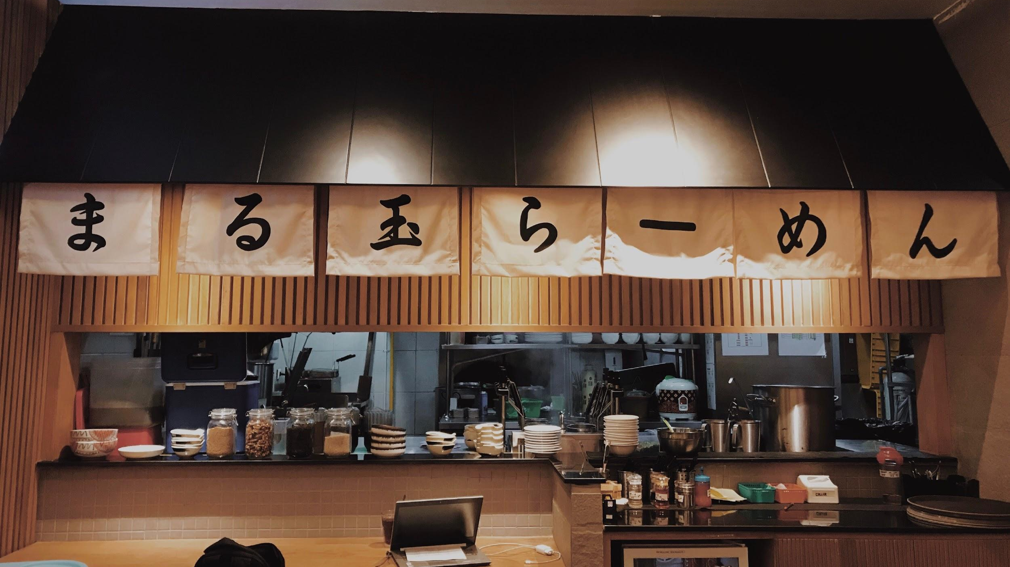
RECRUIT RESTAURANT VISITOR FORECASTING
Jingjing (Olivia) Liang | Samuel Musch | Xiangke Chen | Xuan Ji | Xue Ni | Yassine Manane

Slide 2



Today we deliver and report on:
A model to predict daily visitors for Japanese restaurants
Novel features for the manager to be aware of
An improved understanding of the factors based on prediction results
Notes:
https://sites.google.com/umn.edu/communicating-analytics/better?authuser=1

Slide 3
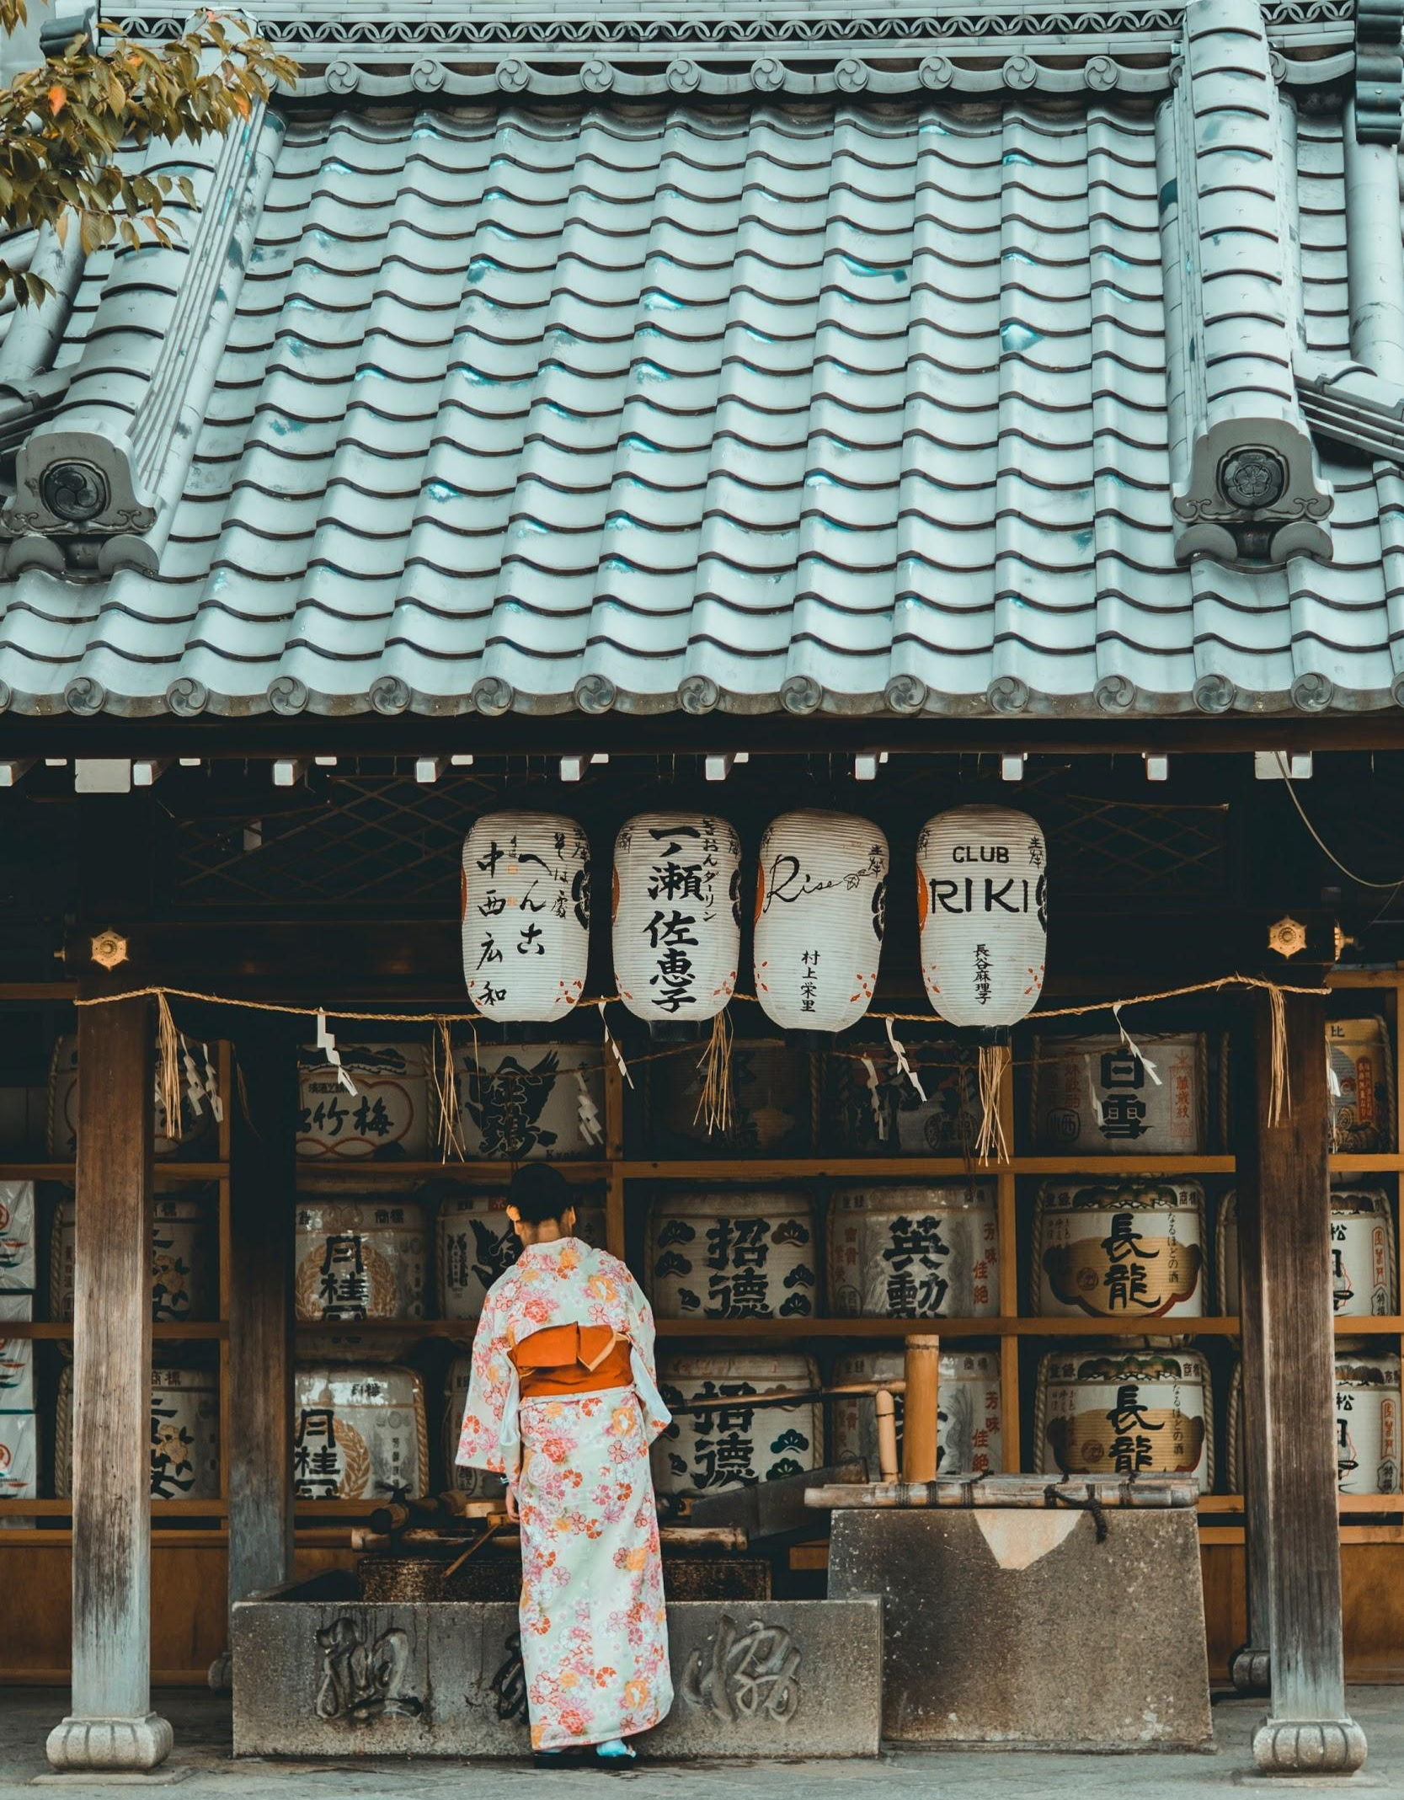
A Restaurant Owner’s Dilemma
What will happen if you don’t know how many people will visit?
Reviews
Food Supply
Staff Allocation
Customer Experience
Notes:
https://sites.google.com/umn.edu/communicating-analytics/better?authuser=1

Slide 4
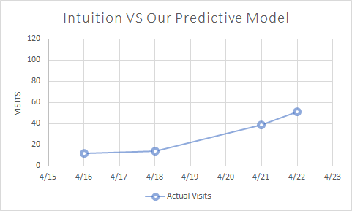
Manager Intuition
BEFORE VS AFTER

Slide 5
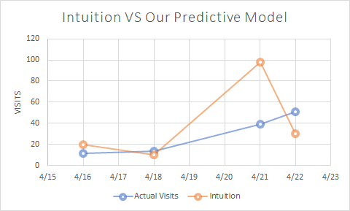
Manager Intuition
BEFORE VS AFTER

Slide 6
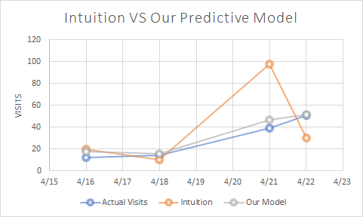
Manager Intuition
BEFORE VS AFTER

Slide 7
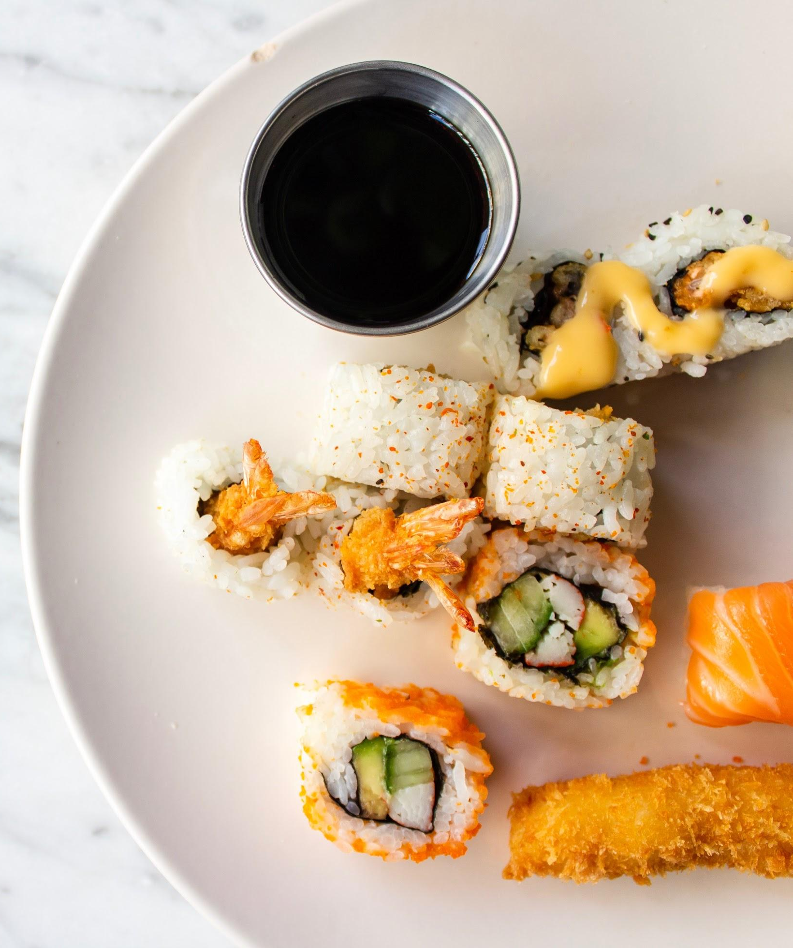


Data Sources
Original Datasets From Kaggle:
Visit & Reservations
Store Information
Calendar Date Information
External Dataset:
Population
Weather data

Slide 8

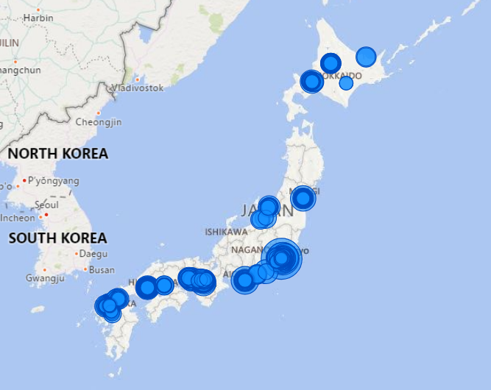

Factors Considered
Time Series Features:
Prior Year Mapping
Days to Previous 25th
(Consecutive) Holidays
Geographic Features:
Location
Population / Density
Visitors Features:
Exponential Moving Average
Aggregation (min, max, mean, median)
Which days stores are closed

Slide 9






Implementation of different models
No data pre-processing
Trends + seasonality
RMSLE - 0.542
State of art for sequence data
RMSLE - 0.50277
SEQ2SEQ
+
LGBM
ARIMA
Feature importance
No statistical assumptions
RMSLE - 0.5214
LSTM
SEQ2SEQ
FACEBOOK PROPHET
Baseline Time Series
External factors
RMSLE - 0.561
Ensemble approach
RMSLE - 0.50002
LIGHT GBM

Slide 10
Implementation Of Different Models
No data pre-processing
Trends + seasonality
RMSLE - 0.542
State of art for sequence data
RMSLE - 0.50277
SEQ2SEQ
+
LGBM
ARIMA
Feature importance
No statistical assumptions
RMSLE - 0.5214
LSTM
SEQ2SEQ
FACEBOOK PROPHET
Baseline Time Series
External factors
RMSLE - 0.561
Ensemble approach
RMSLE - 0.50002
LIGHT GBM

Slide 11


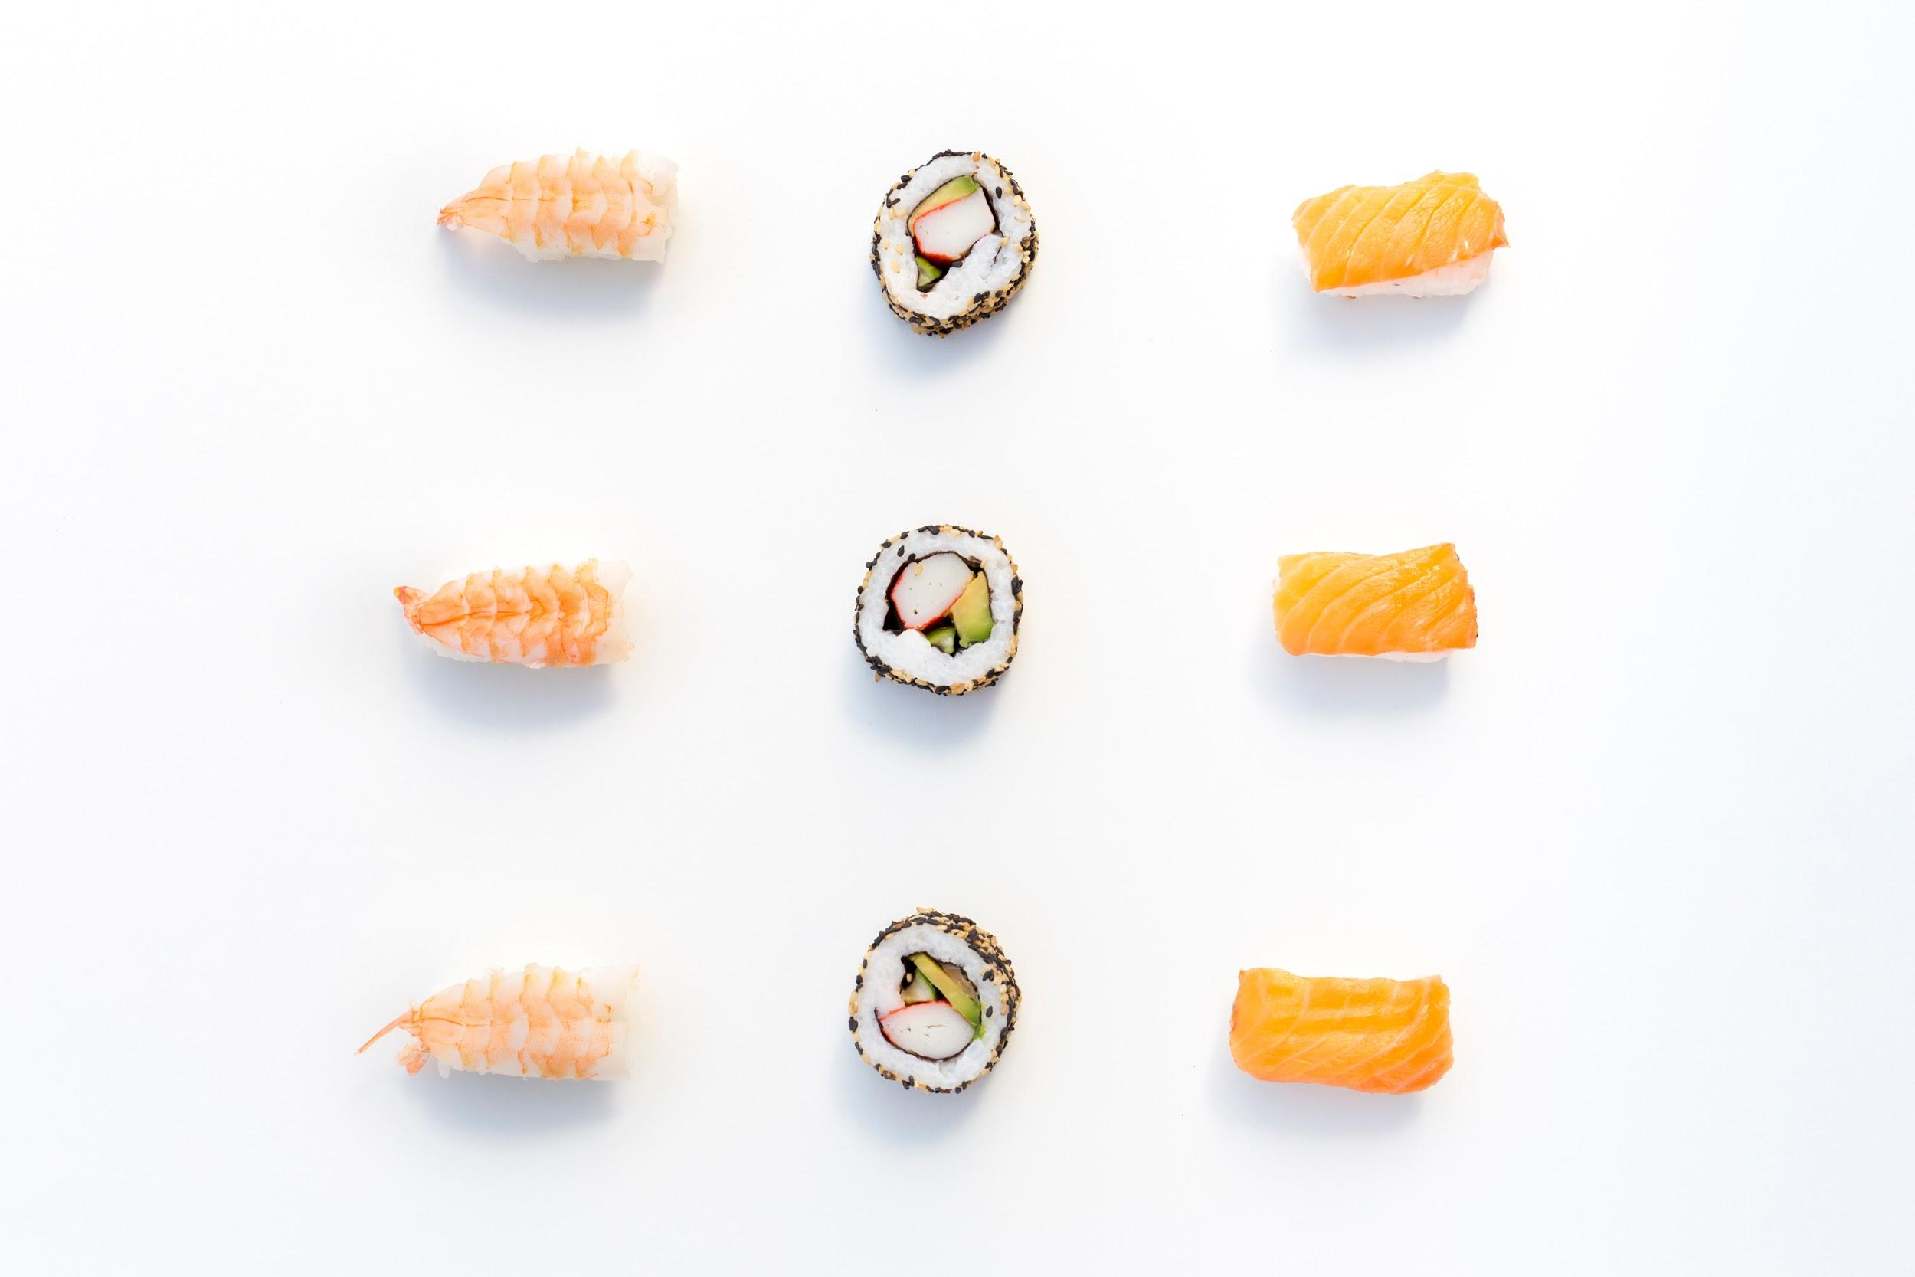




Leverage Time Factors To Improve Predictions
Previous year mapping
Holiday Flag
Aggregated number of visitors
for the same day of week
Lagged # of visitors in last 7 days
Days to last paycheck

Slide 12
Impact and Value
Cut manager intuition error in half
Optimize staff allocation and inventory management
Save expenditures on salary payment
$132 = Minimum wage * 2 waiters * 8 hours
Minimum wage is roughly $8.26 per hour
Generalizable Algorithm

Slide 13
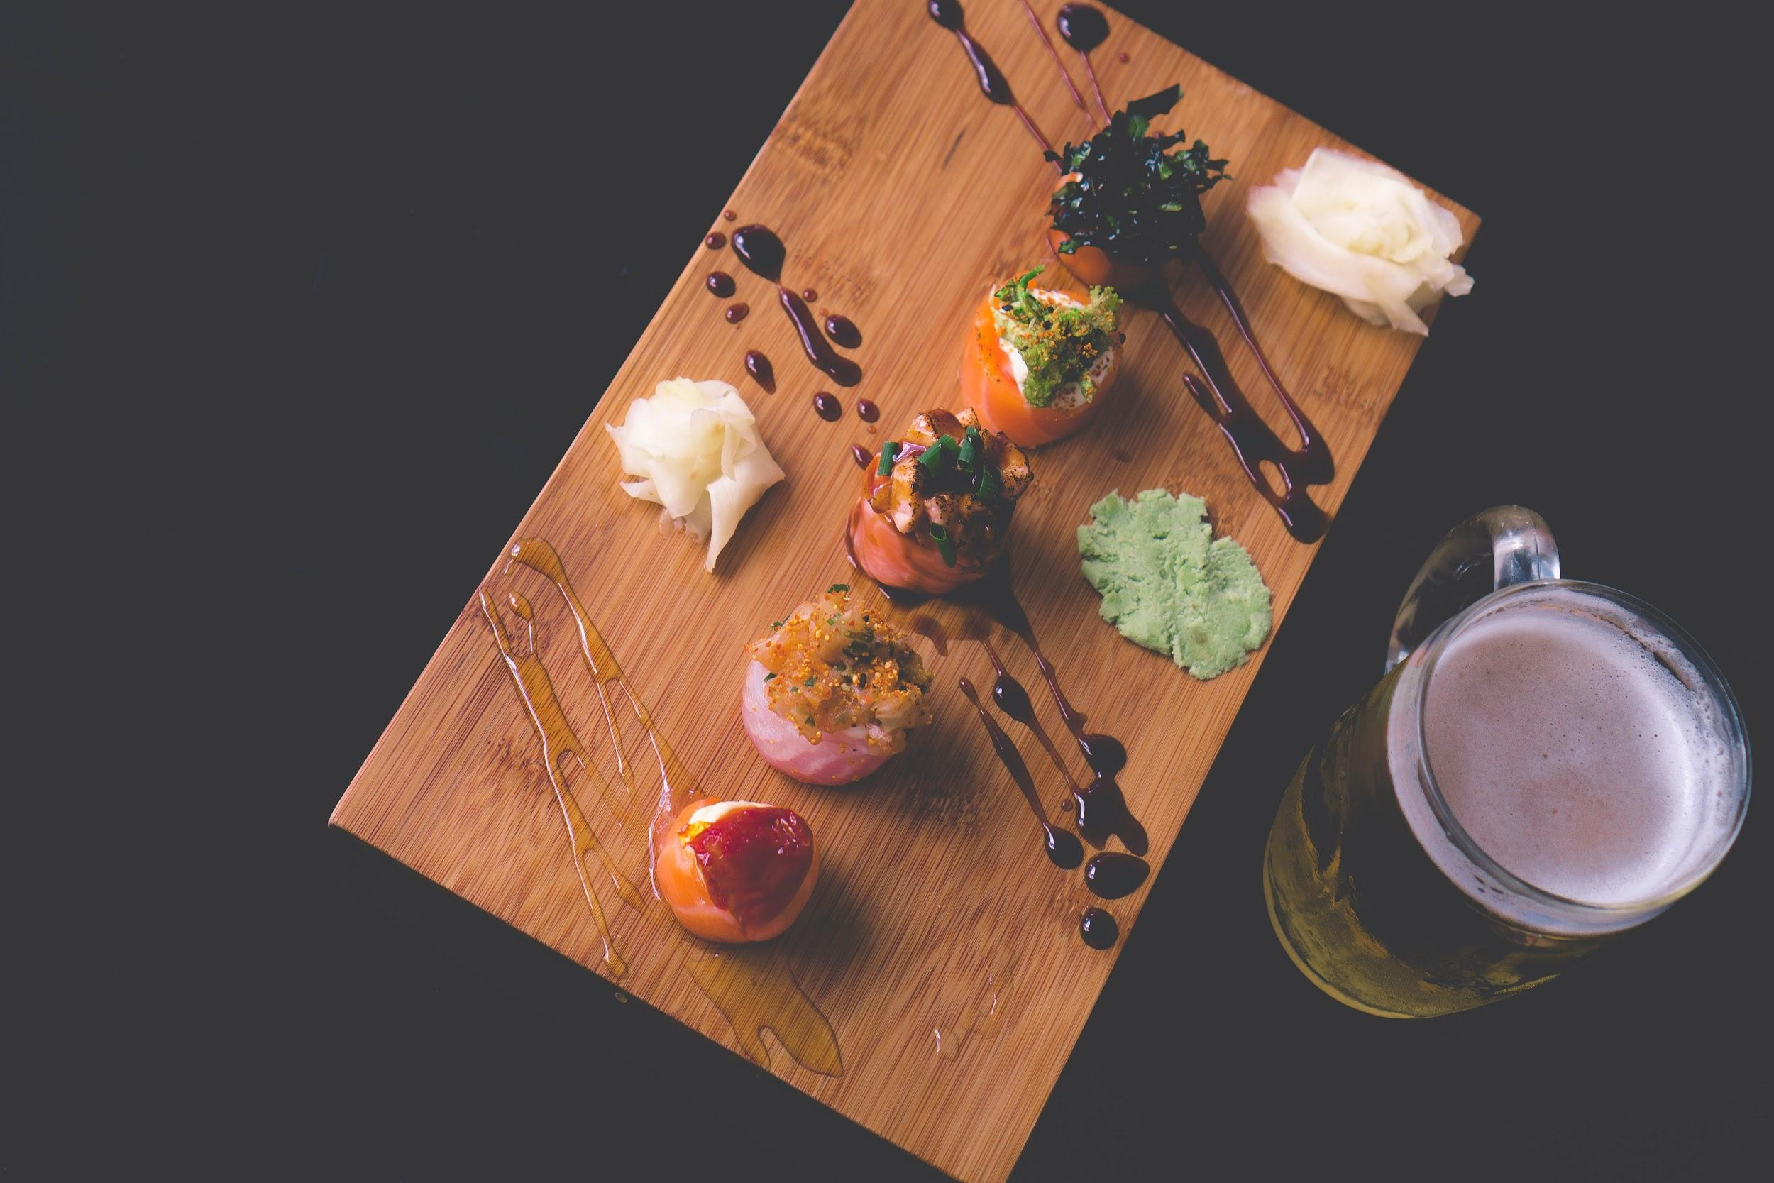
Next Steps
Feature improvement
Weather
Distance from Busiest Area
Modeling improvement
Add Attention Mechanism to RNN model
More diverse model ensembling
Expand the timespan

Slide 14
References
https://blog.keras.io/a-ten-minute-introduction-to-sequence-to-sequence-learning-in-keras.html
https://github.com/Arturus/kaggle-web-traffic
https://github.com/MaxHalford/kaggle-recruit-restaurant/blob/master/Solution.ipynb
https://www.kaggle.com/pureheart/1st-place-lgb-model-public-0-470-private-0-502
https://www.kaggle.com/plantsgo/solution-public-0-471-private-0-505
https://www.kaggle.com/h4211819/holiday-trick
https://www.kaggle.com/c/recruit-restaurant-visitor-forecasting/discussion/49100

Slide 15
THANK YOU FOR YOUR ATTENTION

